Slide 1
What Do We Believe? The Journey of Every Christian Part 11
Christian Marriage Today
Herein is love, not that we loved God, but that he loved us, and sent his Son to be the propitiation for our sins. 11 Beloved, if God so loved us, we ought also to love one another.
I JOHN 4:10-11

Slide 2
Birthdays & Anniversaries
Nov. 28th Madeline Irish
Dec. 1st. Allen &Hannah Gunter

Slide 3
THE.MESSIAH
40 See, that's the thing that delivers the Word. The Word goes right out, and the Holy Spirit follows the Word…
Oh, I like that. I like sound Bible teaching, and the Bible Holy Ghost coming back confirming Bible teaching.
61-0117

Slide 4
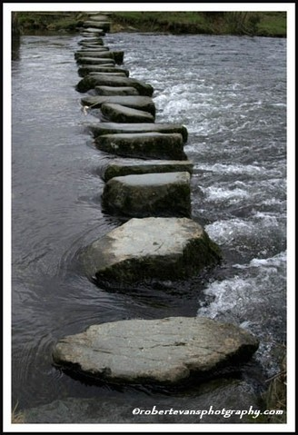
The Journey Risking Everything To Reach Eternity!
Navigating Passageways
GENESIS 2:24
Therefore shall a man leave his father and his mother, and shall cleave unto his wife: and they shall be one flesh.

Slide 5
God: New Birth
Our Witness
Outsiders
The Church
Local Body
Me
Walk in wisdom toward them that are without, redeeming the time.
(Col. 4:5)
So we, being many, are one body in Christ, and every one members one of another. (Rom. 12:5)

Slide 6
God: New Birth
“Two are better than one…”
ECCLESIASTES 4:9
The
Marriage
Relationship

Slide 7
THE.KINSMAN.REDEEMER
45 Yesterday morning we were lying in bed a little late, we got to speaking about different things, "What was hatred?” I said, "Hatred had a beginning so it has to have an end. Love had no beginning, so it has no end. Hatred is forever. Love is eternal.”
And when a man loves a woman and marries her because she's just pretty, there'll be an end to that. But when a man finds a woman that he loves, he don't know why, but he loves her...

Slide 8
And she finds the man that she loves, no matter what he looks like...
He loves her. She loves him. That's an eternal mate in glory. Death nor nothing else can ever separate them. Because they are from eternity, and they stepped out into space of time, and will return back to eternity. Eternity has dropped down in a body called time, then it goes right back up into eternity again. It cannot perish.
60-1002

Slide 9
SPIRITUAL.FOOD.IN.DUE.SEASON
1 Jesus said, "Do you now believe…?” They said, "We believe that Thou knowest all things and need that no man teach Thee." So, Father, tonight we realize that You don't need our teaching, but we need Yours. So we pray that You'll teach us how to pray, how to live, and how to believe. Grant it, Lord. If we lack anything, give it to us, Lord. We ask it in Jesus' Name.
65-0718

Slide 10
Why Do People Get Married?
They have fallen in love;
They feel they are expected to;
They desire a family to repeat a life pattern or to start a positive one;
They want to get away from a bad situation;
Desire to care for or be cared for by someone.

Slide 11
Does Marriage Still Matter?
We Marry For Different Reasons Today But It Is Still An Important Institution
Jun 20, 2010
“If you look at the trends we've seen in this country in the past twenty to thirty years, my guess is that she is far from an aberration and that many who have married in the past two generations (at least) have relied on the knowledge that divorce is an option if things don't work out.”

Slide 12
US Demographics [have] changed and, in 2005, for the first time in history, the scales tipped away from the two parent head of household toward the single parent head of household. People no longer marry to have children and no longer have children when they marry.
There are different reasons for marriage these days and a variety of types of marriages that we see. Given how long we live and how many choices we have in the world today, we no longer have an expectation that we will be with our same spouse until we die.

Slide 13
As much as anyone marrying today may hope in the moment to be with their spouse forever, there are fewer who do so blindly or rigidly - that is, without knowing that divorce is a very real possibility.
Marriage is a wonderful institution in many ways, but the conclusion that I draw is that it is incredibly out-dated as it is. I think it's time we start acknowledging and accepting what is really going on versus what is supposed to happen per the fairy tales we all read as children.”

Slide 15
FROM.THE.BEGINNING.IT.WASN'T.SO
14 God, as we have taught Him that He is infinite. And I hope you're getting this tape; it'll be short, but catch it please. And when God says anything, it must forever be that way. Don't never lose that precious treasure from your heart.
That when God says anything, He can-not improve it; it's perfectly spoke; it will be forever that way. So Jesus referred back on this subject. As we know they were teaching, giving men rights to divorce their wives. And Jesus said, "From the beginning it wasn't so."

Slide 16
They said, "Moses told us that we might have a writing of a divorce if we wish to put our wife away."
Jesus said, "Moses did it because of the hardness of your hearts. But it wasn't so from the beginning. Because God said at the beginning, 'For this cause a man shall leave his father, his mother, and cleave to his wife.'"
So when God said that at the beginning, it can never be changed by anything.
59-1125

Slide 18
God’s Foundation:
Gen. 2:18-25
18 And the LORD God said, It is not good that the man should be alone; I will make him an help meet for him. 19 And out of the ground the LORD God formed every beast of the field, and every fowl of the air; and brought them unto Adam to see what he would call them: and whatsoever Adam called every living creature, that was the name thereof. 20 And Adam gave names to all cattle, and to the fowl of the air, and to every beast of the field;

Slide 19
but for Adam there was not found an help meet for him... 23 And Adam said, This is now bone of my bones, and flesh of my flesh: she shall be called Woman, because she was taken out of Man. 24 Therefore shall a man leave his father and his mother, and shall cleave unto his wife: and they shall be one flesh. 25 And they were both naked, the man and his wife, and were not ashamed.

Slide 20
Foundational Principles
Independent Union: Based on Genesis 2:24, a new relationship is established, a new family unit with its own physical, financial and emotional independence;
Cleave: Good marriages are the result of 2 independent adults clinging tightly to each other. Like plywood!

Slide 21
II KINGS 5:25-27
But he went in, and stood before his master. And Elisha said unto him, Whence comest thou, Gehazi? And he said, Thy servant went no whither. 26 And he said unto him, Went not mine heart with thee, when the man turned again from his chariot to meet thee? Is it a time to receive money, and to receive garments, and oliveyards, and vineyards, and sheep, and oxen, and menservants, and maidservants? 27 The leprosy therefore of Naaman shall cleave unto thee, and unto thy seed for ever. And he went out from his presence a leper as white as snow.

Slide 22
QUESTIONS.AND.ANSWERS.3
304 But if they cannot contain, let them marry: for it is better to marry than to burn.
That's for just dirty living… when they're going together and they know that they should be married, go ahead and get married. Don't just live a dirty little life there, 'cause it's not right. That's your sister in one sense, if you're a Christian. Now, if it's the world: dog eat dog. But this girl that you're going with, that's your sister too. That will be the mother of your children that will come. Don't live a dirty little life around her, show that you're a real Christian gentleman. Live like a Christian gentleman ought to. And treat her like your sister, and when you get married, still treat her that way.
64-0830

Slide 23
QUESTIONS.AND.ANSWERS.3
32 And you husbands to your wives, when they're in that time of life, if she ever was your sweetheart, you let her be right then, 'cause she needs you. She really needs your help; she needs somebody to help her and understand her. Talk to her, take her up in your arms like she was your sweetheart, and she should be. And understand her, because she's going through a time that her entire make-up is changing, and you must be good to her at that time.

Slide 24
309 Understand, talk to your wife. If one nature is to you and another nature to her, talk it with her. You try to do the same thing to him, sister. Understand one another and be real Christian gentlemen and real Christian ladies, brother and sister with one another. Always remember, you're God's children, you're from a royal family… there's no better blood in the world than yours. And a royal blood shows itself. I'm a son of a King; I'm the son of the King. My wife's a daughter of a King. How would I treat that King's daughter? How would she treat that King's son? See what I mean? 64-0830

Slide 25
10 Biblical Building Blocks
Unconditional Love
Commitment
(Cleave)
Respect
Stewardship
Intimacy
Communication
Independent Union
Priorities
Leadership
Spiritual Companionship

Slide 26
My House
PSALM 101:2
I will behave myself wisely in a perfect way. O when wilt thou come unto me? I will walk within my house with a perfect heart.
A place where the Holy Spirit is always welcome;
A place separate from Sodom;
A place where Preparations are Made to leave this world.

Slide 27
My House
Spiritual Priorities: Begin with Faith, Adding Virtues, Showing Christ;
Raising Children: Discipline, Development of Core Values, Respect & Morality;
Stewardship: Work Ethic, Integrity, Finances & Accountability;

Slide 28
Foundational Principles
Companionship: Strong marriages have an emphasis on deep friendship;
Priorities: Adam & Eve had a sole focus: each other;
Leadership: Husbands need to step up and lead. (Not a statement about worth, but the establishment of roles.)

Slide 29
Commitment
"Commitment" is not popular in our culture. Our society emphasizes individual rights, personal freedom, independence and mobility. The idea of giving these up because of dedication to another person or loyalty to a relationship makes a lot of people feel trapped.
But you can’t have it both ways. You can't build a divorce-proof marriage and remain unbending toward your personal rights. That doesn't mean you give up all your freedoms or choices, but it does mean your commitment to the relationship supersedes your individual rights.

Slide 30
LIFE.STORY
70 "Why, they're the happiest people in the world. They're not ashamed of their religion. They just scream, shout, just as free as the water runs. I like that."
She said, "It's just what other churches has kicked out. It's nothing but a bunch of trash.” I come to find out, what she called trash, is the cream of the crop. So I said, "Well, that's my wife."

Slide 31
She said, "But, it's my daughter. She can go. If she goes, her mother will go to a grave broken-hearted.” Then Hope started crying.
She said, "That's where I made my fatal mistake, right there."
So she said, "Well, if you want to, if you want to go, I'll go with you."
71 And we went on, talked it over. Instead of listening to God, I listened to the woman.
53-1108A

Slide 32
THE.UNWELCOMED.CHRIST
“But we got other things to do. The children has got to be taken care of. We can't go to church, too many kiddies to get ready." Take them, anyhow. "Well, the neighbors will say something." What do you care what the neighbors says?
Use every opportunity. Get to Jesus; that's the main thing. Don't be took up with the affairs of the world. We spend too much time on those things. Make your way to Him. And when you get there, pour out your soul to Him.
55-0911

Slide 33
THINGS.THAT.ARE.TO.BE
…I believe that Heaven is a place just as real as this, where we don't set up there for Eternity and just set there on a cloud. We don't just strum our harp forever. But we're going to a real place where we're going to do things, where we're going to live… to work… to enjoy… to live. We're going to Life, real Eternal Life. We're going to a Heaven, a paradise. Just like Adam and Eve worked, and lived, and eat, and enjoyed, in the garden of Eden before sin came in, we're on our road right back there again, right back.
65-1205

Slide 34
Unconditional Love
“But I don’t love her anymore!”
EPHESIANS 5:25
Husbands, love your wives,
even as Christ also loved the church,
and gave himself for it;

Slide 35
Unconditional Love
“In many ways, we seem more like neighbors than husband and wife.”
MATTHEW 22:37-39
37 Jesus said unto him, Thou shalt love the Lord thy God with all thy heart, and with all thy soul, and with all thy mind. 38 This is the first and great commandment.39 And the second is like unto it, Thou shalt love thy neighbour as thyself.

Slide 36
Unconditional Love
“We disagree constantly. In many ways, we seem more like enemies these days.”
LUKE 6:35
But love ye your enemies, and do good, and lend, hoping for nothing again; and your reward shall be great, and ye shall be the children of the Highest: for he is kind unto the unthankful and to the evil.

Slide 37
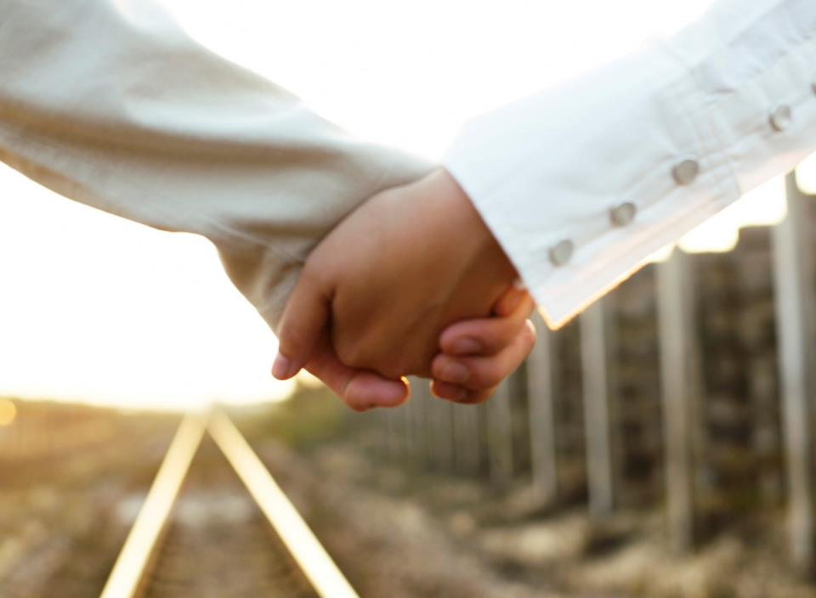
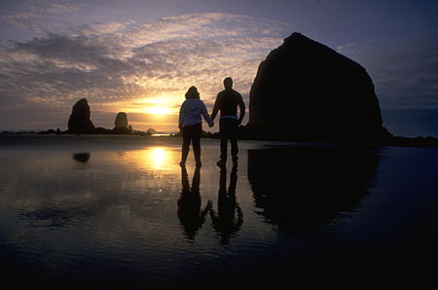
And Adam said, This is now bone of my bones, and flesh of my flesh: she shall be called Woman, because she was taken out of Man. Genesis 2:23

