Slide 1
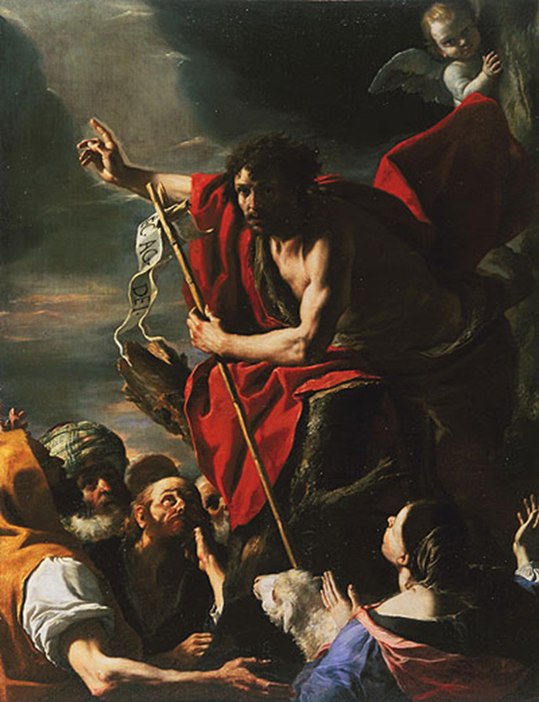
The Final Voice to the Final Age Part 13
EZEKIEL 2:5
And they, whether they will hear, or whether they will forbear, (for they are a rebellious house,) yet shall know that there hath been a prophet among them.

Slide 2
Birthdays & Anniversaries
Aug. 5th Josh Godwin
Aug. 6th Lydie Ivy
Aug. 7th Tracy Rabon
Aug. 8th Ethan & Anna Pritchard
Aug. 9th Andy Irish
Aug. 12th Dennis & Sue Sheppard

Slide 3
CHURCH.AGE.BOOK
340-1 Then God sent Wesley, and he was the voice with the Word in his day. The people who took his revelation from God became the living epistles read and known of all men for their generation. When the Methodists failed, God raised up others and so it has gone on through the years until in this last day there is again another people in the land, who under their messenger will be the final voice to the final age.

Slide 4
Q&A ON.THE.SEALS
22. Would the Bride of Christ have a ministry before the rapture?
Sure. That's what's going on right now. The Bride of Christ... Certainly. It is the Message of the hour, the Bride of Christ. Sure, She's consist of apostles, prophets, teachers, evangelists, and pastors. That's the Bride of Christ.
63-0324

Slide 5
GOD'S.ONLY.PROVIDED.PLACE
40 I believe the church is beginning to hear the Message, and beginning to understand It. But we've got to lay in the Presence of the Son, we've got to be ripened. Our faith isn't ripe. Intellectually we're hearing the Message that God has give us, and seeing the signs that He showed us, and proving it by the Bible, but, how the church needs to lay in His Presence till it tenders up, you know, and gets sweet in the Spirit...

Slide 6
Sometime in speaking the Message, you get harsh, have to break it in like that, because you've got to clinch a nail to make it hold. But when the Church once gets It, the Elected is called out and separated, then in the Presence of God, I know it'll be something like the people was there when it takes its Rapture.
65-1128

Slide 7
I.KNOW.MY.REDEEMER.LIVETH
14 Then we find that in the day that all of the world was going to be destroyed by a flood that God made a preparation. A preparation for what cause? To preserve His purpose. He did it in the days of Noah, and He's doing it today. He has made a preparation to conserve to His own purpose. He will conserve a church. He will conserve a people. Nothing can destroy it. It has been planted. It is the seed of God… It is a purpose of God to show us signs, and wonders, and miracles.

Slide 8
It's a purpose of God and nothing can destroy it. All powers of hell might wager against it, but it will prevail. We have God's eternal promise. There may be… isms rise; great prog-rams rise; there may be things that look like that it would be destroyed; but it can never be destroyed. It is the purpose of God to see that it will prevail.
Then it's not up to me, and it's not up to you whether it will be destroyed or not. It's up to God. And we can rest assured on it, that God will never let our heritage be destroyed; for it's His purpose to give it to us. 58-0406

Slide 9
REVELATION 7:1-4
1 And after these things I saw four angels standing on the four corners of the earth, holding the four winds of the earth, that the wind should not blow on the earth, nor on the sea, nor on any tree. 2 And I saw another angel ascending from the east, having the seal of the living God: and he cried with a loud voice to the four angels, to whom it was given to hurt the earth and the sea, 3 Saying, Hurt not the earth, neither the sea, nor the trees, till we have sealed the servants of our God in their foreheads. 4 And I heard the number of them which were sealed: and there were sealed an hundred and forty and four thousand of all the tribes of the children of Israel.

Slide 10
MARK.OF.THE.BEAST & THE.SEAL.OF.GOD.2
51 (WWI) stop mysteriously... What did it? God's issue went forth to hold it. "Hold the four winds." "Winds" means "war and strife." Until we have got Israel back in Palestine again, "Hold the four winds," and it stopped right there on the eleventh hour...
Remember Jesus speaking of the eleventh hour, people…? The eleventh hour people got the same wage the one did that come in the first hour. Then the baptism of the Holy Ghost has to go right back and seal the Jew, like the first one was sealed, that eleventh hour people. "Hold the four winds; don't let the world be destroyed until we seal the servants of our God in their forehead.“
61-0217

Slide 11
I SAMUEL 9:9
(Beforetime in Israel, when a man went to enquire of God, thus he spake, Come, and let us go to the seer: for he that is now called a Prophet was beforetime called a Seer.)
Doesn’t come by laying on of hands:
JEREMIAH 1:5
Before I formed thee in the belly I knew thee; and before thou camest forth out of the womb I sanctified thee, and I ordained thee a prophet unto the nations.
JEREMIAH 23:28
The prophet that hath a dream, let him tell a dream; and he that hath my word, let him speak my word faithfully. What is the chaff to the wheat? saith the LORD.

Slide 12
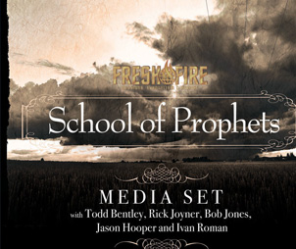
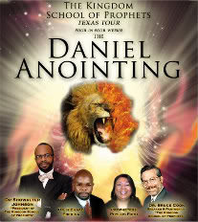

Slide 13
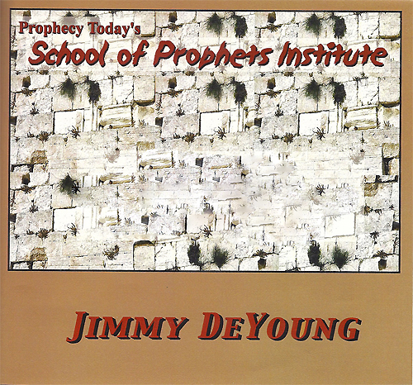

Slide 15
I CORINTHIANS 3:5-9
Who then is Paul, and who is Apollos, but ministers by whom ye believed, even as the Lord gave to every man? 6 I have planted, Apollos watered; but God gave the increase.7 So then neither is he that planteth any thing, neither he that watereth; but God that giveth the increase. 8 Now he that planteth and he that watereth are one: and every man shall receive his own reward according to his own labour. 9 For we are labourers together with God: ye are God's husbandry, ye are God's building.

Slide 16
THINGS.THAT.ARE.TO.BE
14 Now, we know that this is the day of salvation, where God is calling men from the world, from a life of sin, unto a life of service… I'm very thankful for these open doors that I've had, and the inspiration it's give to young men like your pastor here. As I'm beginning to get old, and know that my days are numbered, and know now that these young men can take this Message and sweep It on to the Coming of the Lord, if He doesn't come in my generation.
65-1205

Slide 17
CHURCH.AGE.BOOK
340-2 The church is no longer the "mouthpiece" of God. It is its own mouthpiece. So God is turning on her.
He will confound her through the prophet and the bride, for the voice of God will be in her.

Slide 18
THE.UNVEILING.OF.GOD
155 Notice, only Moses had the Word. He got one man. He can't get two or three different minds. He takes one man. Moses had the Word, and Moses alone. Joshua even didn't have It. No one else had It. Amen! Joshua was a general, commander of the army; Joshua was a believer, a Christian. But Moses was a prophet!
The Word can't come to Joshua; It's got to come to Moses. He was the major prophet of the hour. Notice, the Word never did come to Joshua till Moses was gone.
64-0614

Slide 19
NUMBERS 12:6
And he said, Hear now my words: If there be a prophet among you, I the LORD will make myself known unto him in a vision, and will speak unto him in a dream.
Tests of a true Prophet:
Deut. 18:18 [Moses]
I will raise them up a Prophet from among their brethren, like unto thee, and will put 'my words' in his mouth; and he shall speak unto them all that I shall command him.
A "prophet" is someone who can foretell the future. The prophets of the BIBLE often made predictions, which confirmed their authority when the predictions came true, but changing the lives of their people was a more central part of their mission.

Slide 20
DEUTERONOMY 18:19
And it shall come to pass, that whosoever will not hearken unto my words which he shall speak in my name, I will require it of him. 20 But the prophet, which shall presume to speak a word in my name, which I have not commanded him to speak, or that shall speak in the name of other gods, even that prophet shall die.
[Presume]- presumptuous, arrogant, rebelliously, proud-to take upon oneself without permission, taking for granted.

Slide 21
21 And if thou say in thine heart, How shall we know the word which the LORD hath not spoken?22 When a prophet speaketh in the name of the LORD, if the thing follow not, nor come to pass, that is the thing which the LORD hath not
spoken, but the prophet hath spoken it presumptuously: thou shalt not be afraid of him.

Slide 22
THE.SUPER.SIGN
55 And a seer was the one who had the interpretation of the written Word, and he foresaw things that was to come.
And when he spoke of the things that was to come, and proved that he was a seer, then he knowed. They knowed he had the right interpretation of the Scripture, because God, through him, manifested the written Scripture for that day.

Slide 23
Don't be slothful. Wake up! That was the plain identification, a seer, a forth-teller and a teller-forth. And the only way that they knowed he was getting the right interpretation to the Scripture, because what he said come to pass.
63-1129

Slide 24
Example: DEUTERONOMY 18:15
The LORD thy God will raise up unto thee a Prophet from the midst of thee, of thy brethren, like unto me; unto him ye shall hearken;
ACTS 7:36
He brought them out, after that he had shewed wonders and signs in the land of Egypt, and in the Red sea, and in the wilderness forty years. 37 This is that Moses, which said unto the children of Israel, A prophet shall the Lord your God raise up unto you of your brethren, like unto me; him shall ye hear.

Slide 25
Example: JEREMIAH 29:10
For thus saith the LORD, That after seventy years be accomplished at Babylon I will visit you, and perform my good word toward you, in causing you to return to this place. 11 For I know the thoughts that I think toward you, saith the LORD, thoughts of peace, and not of evil, to give you an expected end.
DANIEL 9:2-3
In the first year of his reign I Daniel understood by books the number of the years, whereof the word of the LORD came to Jeremiah the prophet, that he would accomplish seventy years in the desolations of Jerusalem. 3 And I set my face unto the Lord God, to seek by prayer and supplications, with fasting, and sackcloth, and ashes:

Slide 26
HIS.UNFAILING.WORDS.OF.PROMISE
41 God always sends a prophet. The Word comes to the prophet; the written Word, a discerner of the thoughts of the heart… He knowed that he was a prophet, because the Word of God discerns the thought in the heart, foretells things, forth-teller and teller-forth. Did you ever take the old Hebrew dictionary, and see what the word seer means? It's the one that has the Divine revelation of the written Word. And how it's vindicated, he foresees things that he foretells, and they come to pass.
64-0120

Slide 27
IDENTIFIED.CHRIST.OF.ALL.AGES
49 Each time He appeared on the earth, at the end of an age, He always sent a man and anoint him with the Holy Ghost, Christ… the Logos, and It comes to identify the Words of that age.
"The Word of the Lord comes to the prophets" and identifies that age. See, He does nothing outside of man. Now He can't do it in a group. It just never has been done. He never did use a group; never did. He uses one single person.
64-0401

Slide 28
DEUTERONOMY 13:1-4
If there arise among you a prophet, or a dreamer of dreams, and giveth thee a sign or a wonder, 2 And the sign or the wonder come to pass, whereof he spake unto thee, saying, Let us go after other gods, which thou hast not known, and let us serve them; 3 Thou shalt not hearken unto the words of that prophet, or that dreamer of dreams: for the LORD your God proveth you, to know whether ye love the LORD your God with all your heart and with all your soul. [Proveth-to establish as true, to establish the validity] 4 Ye shall walk after the LORD your God, and fear him, and keep his commandments, and obey his voice, and ye shall serve him, and cleave unto him.

Slide 29
HEBREWS
114-188 Joseph said, "Don't you move my bones from here until you go to that promised land, and bury me up there with the rest of my fathers." 'Cause he knowed the resurrection was coming, when Jesus rose from the dead; 'cause he'd known what Job said. See, each one of them prophets knowed just what the other prophet had said, and knowed that their Spirit was the same; and they was watching. Oh, that ought to shake us out of our worried condition. They had their eyes, not on what people were saying, but what them prophets said; each one of them was watching. Abraham said, "Bury me right here where Job was buried." Said, "Sarah, I'm going to buy a piece of ground; we're going to be buried right here.“
57-0901

Slide 30
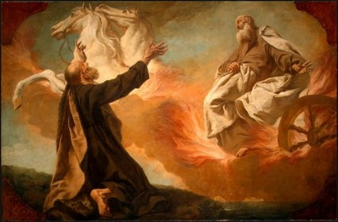
Scripturally Dividing Between
the Ministries of: John The Baptist & William Branham.

Slide 31
Both anointed with the Spirit of Elijah:
MALACHI 4:5-6
Behold, I will send you Elijah the prophet before the coming of the great and dreadful day of the LORD: 6 And he shall turn the heart of the fathers to the children, and the heart of the children to their fathers, lest I come and smite the earth with a curse.
Let’s look at John the Baptist:
ISAIAH 40:3
The voice of him that crieth in the wilderness, Prepare ye the way of the LORD, make straight in the desert a highway for our God.

Slide 32
MATTHEW 3:1-3
In those days came John the Baptist, preaching in the wilderness of Judaea, 2 And saying, Repent ye: for the kingdom of heaven is at hand. 3 For this is he that was spoken of by the prophet Esaias, saying, The voice of one crying in the wilderness, Prepare ye the way of the Lord, make his paths straight.

Slide 33
Prepare (Gr.) hetoimazo
To make ready, prepare: to make the necessary preparations, get everything ready; figuratively, drawn from the oriental custom of sending people on before kings on their journeys to level the roads and make them passable; to prepare the minds of men to give the Messiah a fit reception and secure his blessings.

Slide 34
MARK 1:1-4
The beginning of the gospel of Jesus Christ, the Son of God; 2 As it is written in the prophets, Behold, I send my messenger before thy face, which shall prepare thy way before thee. 3 The voice of one crying in the wilderness, Prepare ye the way of the Lord, make his paths straight. 4 John did baptize in the wilderness, and preach the baptism of repentance for the remission of sins.

Slide 35
JOHN 1:19-25
And this is the record of John, when the Jews sent priests and Levites from Jerusalem to ask him, Who art thou? 20 And he confessed, and denied not; but confessed, I am not the Christ. 21 And they asked him, What then? Art thou Elias? And he saith, I am not. Art thou that prophet? [Deut 18:15] And he answered, No. 22 Then said they unto him, Who art thou? that we may give an answer to them that sent us. What sayest thou of thyself? 23 He said, I am the voice of one crying in the wilderness, Make straight the way of the Lord, as said the prophet Esaias. [This, again, is preparation for the coming Messiah] 24 And they which were sent were of the Pharisees. 25 And they asked him, and said unto him, Why baptizest thou then, if thou be not that Christ, nor Elias, neither that prophet?

Slide 36
MALACHI 4:5-6
Behold, I will send you Elijah the prophet before the coming of the great and dreadful day of the LORD: 6 And he shall turn the heart of the fathers to the children, and the heart of the children to their fathers, lest I come and smite the earth with a curse.
Compound Reference:
1.) Elijah comes before the “great” and “dreadful.”
2.) “Great” was His first coming, what He did for His elect. (Lk. 4)
3.) “Dreadful” is the “Day of the Lord, time of judgment upon earth and those who have rejected the grace offered in His great plan of salvation.

Slide 37
The Day of the Lord
I THESSALONIANS 5:2-3
For yourselves know perfectly that the day of the Lord so cometh as a thief in the night. 3 For when they shall say, Peace and safety; then sudden destruction cometh upon them, as travail upon a woman with child; and they shall not escape.
II PETER 3:10
But the day of the Lord will come as a thief in the night; in the which the heavens shall pass away with a great noise, and the elements shall melt with fervent heat, the earth also and the works that are therein shall be burned up.
Isaiah 2:10 – 22 / 13:9 – 16 / 34:1 – 8

Slide 38
Half of the Malachi prophecy is John the Baptist:
LUKE 1:17 And he shall go before him in the spirit and power of Elias, to turn the hearts of the fathers to the children, and the disobedient to the wisdom of the just; to make ready a people prepared for the Lord.
MATTHEW 17:10 And his disciples asked him, saying, Why then say the scribes that Elias must first come? 11 And Jesus answered and said unto them, Elias truly shall first come, and restore all things. {Notice the future tense. Shall come.} 12 But I say unto you, That Elias is come already, and they knew him not, but have done unto him whatsoever they listed. Likewise shall also the Son of man suffer of them.

Slide 39
Now, Jesus said John the Baptist was Elijah:
Mt. 11:7-14
For all the prophets and the law prophesied until John. And if ye will receive it, this is Elias, which was for to come.
John 1:19-21
“And this is the record of John, when the Jews sent priests and Levites from Jerusalem to ask him, Who art thou? And he confessed, and denied not: but confessed, I a not the Christ, And they asked him, What then” Art thou Elias? And he answered, No.”

Slide 40
That’s odd! Jesus said John was Elijah, and John said he wasn’t.
Does the Bible contradict itself? Not at all. Remember the Jews were expecting the Messiah to destroy the Romans and set Israel up as the rulers of the world. They were expecting an Elijah to forerun a Messiah who would come in Power.
John said, “No, I’m not that Elijah,” for he was not sent “before the coming of the great and dreadful day of the Lord.”

Slide 41
John 1:22-23
“Then said they unto him, Who art thou? That we may give an answer to them that sent us, What sayest thou of thyself? He said, I am the voice of one crying in the wilderness. Make straight the way of the Lord.”

Slide 42
Isaiah 40:3-5
The voice of him that crieth in the wilderness, Prepare ye the way of the LORD, make straight in the desert a highway for our God. 4 Every valley shall be exalted, and every mountain and hill shall be made low: and the crooked shall be made straight, and the rough places plain:5 And the glory of the LORD shall be revealed, and all flesh shall see it together: for the mouth of the LORD hath spoken it.

Slide 43
MATTHEW 17:10
And his disciples asked him, saying, Why then say the scribes that Elias must first come? 11 And Jesus answered and said unto them, Elias truly shall first come, and restore all things.
12 But I say unto you, That Elias is come already, and they knew him not, but have done unto him whatsoever they listed. 13 Then the disciples understood that he spake unto them of John the Baptist.”

Slide 44
THE.VOICE.OF.THE.SIGN
147 God never did deal with a group, nowhere in the Scripture. He deals with one individual… Paul had the revelation of Who He was... His revelation was so great, He let him write the Bible, like Moses of the Old. That great man, Paul, that revelation he knew that Jesus of the New Testament was Jehovah of the Old.
149 …Now, Elijah was not a group, John the Baptist was not a group, they were one individual. God, Malachi 4, doesn't say, "I'll send a group." Said, "I'll send Elijah!" The Word cannot be changed. Now, the end-time sign and Voice will come in the Scripture order as it was promised.
64-0313

Slide 45
Where did he get that understanding?
The Gospel writers were “scribes” but not bringing foundational revelations for the ages. Where did that come from?
That Pillar of Fire, giving revelation to a man on earth for the Bride of the Age.

Slide 46
THE.FIRST.SEAL
119-2 The first 3 books of Revelations is the church ages... Now, there's 7 church ages, 7 seals, 7 trumpets, vials, unclean spirits like frogs, all this goes together. My, how I'd like to have a great big map and draw it all across the way I see it; just how that each one takes its place.
I drawed it out on a little sheet of paper... And everything so far hit just exactly right. The time and the ages as they have come and gone, everything has blended in just perfectly right.
63-0318

