Slide 1
Just Before….
The Final Voice to the Final Age
Part 10
II TIMOTHY 3:1-5
This know also, that in the last days perilous times shall come.

Slide 2
Birthdays & Anniversaries
July 3rd Peter Coffey, Anna Pritchard
July 6th Danielle Swafford
July 7th Makayla Swafford,
Haven Grace Pritchard
July 8th Barry & Becky Coffey
Julien Ivy

Slide 3
IDENTIFICATION
26 Lord, spread forth Your great holy wings tonight. And may Your august Presence be so felt among us, that we'll fear. God, we want to know just our standing place now.
We're checking up, taking inventory of our lives. It might be just before the Rapture, the call away.
63-0123

Slide 4
JOHN 1:22 Then said they unto him, Who art thou? that we may give an answer to them that sent us. What sayest thou of thyself? 23 He said, I am the voice of one crying in the wilderness, Make straight the way of the Lord, as said the prophet Esaias.
MATTHEW 25:6 And at midnight there was a cry made, Behold, the bridegroom cometh; go ye out to meet him .7 Then all those virgins arose, and trimmed their lamps.
REVELATION 10:7 But in the days of the voice of the seventh angel, when he shall begin to sound, the mystery of God should be finished, as he hath declared to his servants the prophets.

Slide 5
HEBREWS 3:14
For we are made partakers of Christ, if we hold the beginning of our confidence stedfast unto the end; 15 While it is said, To day if ye will hear his voice, harden not your hearts, as in the provocation.

Slide 6
ROMANS 10:14
How then shall they call on him in whom they have not believed? and how shall they believe in him of whom they have not heard? and how shall they hear without a preacher? 15 And how shall they preach, except they be sent? as it is written, How beautiful are the feet of them that preach the gospel of peace, and bring glad tidings of good things!

Slide 7
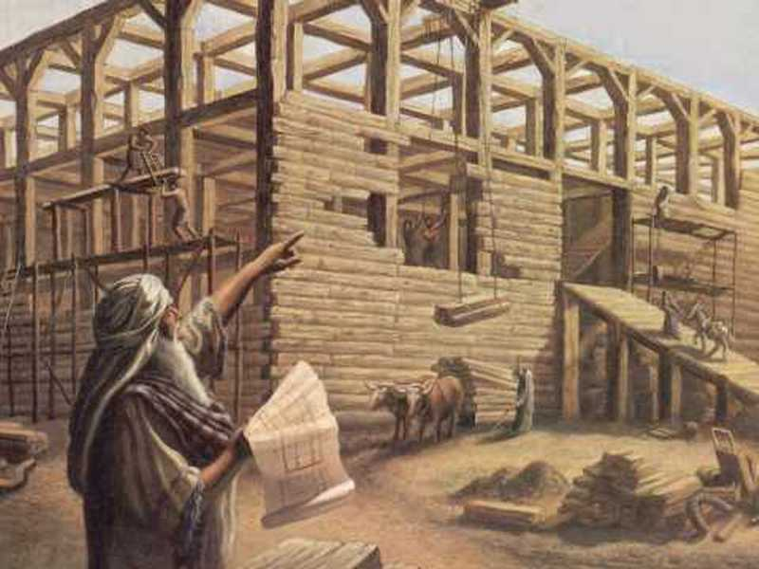
HEB. 11:7
By faith Noah, being warned of God of things not seen as yet, moved with fear, prepared an ark to the saving of his house; by the which he condemned the world, and became heir of the righteousness which is by faith.

Slide 8
ISAIAH 57:15
For thus saith the high and lofty One that inhabiteth eternity, whose name is Holy; I dwell in the high and holy place, with him also that is of a contrite and humble spirit, to revive the spirit of the humble, and to revive the heart of the contrite ones.

Slide 9
ELIJAH & THE.MEAL.OFFERING
49 God doesn't require an education and a lot of nonsense; He requires a surrendered heart to His will.
He doesn't ask you to dress in a certain way, or go to certain colleges, or degrees. He asks for a humble, contrite, broken spirit, and a willing heart to receive Him.
60-0310

Slide 10
THE.SEVEN.CHURCH.AGES
69 You can get forgiveness for crucifying Jesus. You can get forgiveness for taking His Name in vain. "But who speaks against the Holy Ghost will never be forgiven him in this world or the world to come." We're in the last day; so be careful.
Walk humbly. Have a contrite, broken spirit, a humble heart, willing to let the Holy Spirit lead you. Amen.
54-0512

Slide 11
THE.FEAST.OF.THE.TRUMPETS
257 Remember, the Bride is already in Heaven; Joseph's wife was in the palace. And Joseph dismissed everything from around him, and he made hisself known to his brothers; you see, His Wife and children and them was in the palace when He returns back to make Hisself known to the Jews.
64-0719M

Slide 12
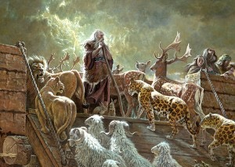
MATTHEW 24:38
38 For as in the days that were before the flood they were eating and drinking, marrying and giving in marriage, until the day that Noe
entered into
the ark…

Slide 13
II TIMOTHY 3:1-5
This know also, that in the last days perilous times shall come. 2 For men shall be lovers of their own selves, covetous, boasters, proud, blasphemers, disobedient to parents, unthankful, unholy, 3 Without natural affection, trucebreakers, false accusers, incontinent, fierce, despisers of those that are good, 4 Traitors, heady, highminded, lovers of pleasures more than lovers of God; 5 Having a form of godliness, but denying the power thereof: from such turn away.

Slide 14
ANOINTED.ONES.AT.THE.END.TIME
120 You that don't have your Bible, listen close. “This know also, that in the last days...
Underline, "last days." That's when it's going to happen.... perilous times shall come. (We're in it.)
For men shall be lovers of their own selves, covetous, boasters, proud, blasphemers, disobedient to parents, unthankful, unholy…
121 Look at this bunch that we got today, rotten. Even in man out on the street, young man, pulling their hair down on their forehead, like with bangs like a woman. Perversion! Sodomites!
65-0725

Slide 16
Disobedient (Gr.) apeithes
Impersuasible, not compliant, contumacious.
TITUS 3:3
For we ourselves also were sometimes foolish, disobedient, deceived, serving divers lusts and pleasures, living in malice and envy, hateful, and hating one another.
ROMANS 1:30
Backbiters, haters of God, despiteful, proud, boasters, inventors of evil things, disobedient to parents…

Slide 17
LUKE 1:17
And he (JB) shall go before him in the spirit and power of Elias, to turn the hearts of the fathers to the children, and the disobedient to the wisdom of the just; to make ready a people prepared for the Lord.

Slide 18
THE.DEITY.OF.JESUS.CHRIST
89 The time's coming when women and men are just about alike. They dress so much alike you can't tell one from the other. All the things that the Bible said would come to pass, it's here… They act alike, look alike, talk alike, talk alike. The Bible said it would be that way. He said, "In the last days, that perilous times would come. Men would be lovers of their own selves, more than lovers of God; trucebreakers, false accusers.”
49-1225

Slide 19
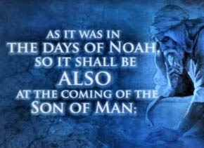
“…before the flood”
Arrogant. Violence Prevailed.
Relied on Science and logic.
Immorality Abounded.
A Time of Mercy Spurned.
The End Came Suddenly.

Slide 20
II PETER 3:10
But the day of the Lord will come as a thief in the night; in the which the heavens shall pass away with a great noise, and the elements shall melt with fervent heat, the earth also and the works that are therein shall be burned up.
I THESSALONIANS 5:1-3
1 But of the times and the seasons, brethren, ye have no need that I write unto you. 2 For yourselves know perfectly that the day of the Lord so cometh as a thief in the night. 3 For when they shall say, Peace and safety; then sudden destruction cometh upon them, as travail upon a woman with child; and they shall not escape.

Slide 21
QUESTIONS.AND.ANSWERS.4
396. Do you believe that sometime the little living Bride will gather somewhere together and have all things in common, as did the first Bride, perhaps just before the coming of the Lord Jesus in the clouds?
Now, they asked me did I believe it. I can't prove it by the Scriptures, but perhaps there will come a time, maybe, I don't know... He said, "But He comes like a thief in the night." Like Romeo and Juliet, He comes and takes away His Bride at night. She's caught away in a moment in a twinkling of an eye.

Slide 22
And it's very doubtful whether it'll be that way, because the Bible said, "There'll be two in a bed; I'll take one and leave one; and two in the field, and I'll take one and leave one." Across the world, they won't be gathered in one place to have things in common. But little groups of them will be scattered all over the earth. Maybe another little group in Asia, one down in Germany, one down somewhere else. When I seen a vision of the Bride the other night, they was made up from the international.
So the Bride won't be gathered from one place; It'll be gathered from all over the world. And that exactly vindicates with the Word, and never has the Word been wrong. And to this time, neither has the vision ever been wrong, because it's been according to the Word. 64-0830

Slide 23
PERSEVERANT
18 And the world was wicked, as it is today, full of science and great man. They had sprung from the sons of Cain. The sons of Seth were humble shepherds, farmers. But the sons of Cain were wise man, builders, inventors, scientists, real smart, real religious. And they had their own form of godliness, but was denying, as it is today,

Slide 24
the power of God. And Noah being a just man before God, one day God met him in the fields and talked to him, and told him to build an ark, because He was going to destroy the world with water.
20 Now that was absolutely contrary to all scientific measurements of that day… it had never rained. There was no moisture in the air.
64-0305

Slide 25
PERSEVERANT
18 And the world was wicked, as it is today, full of science and great man. They had sprung from the sons of Cain. The sons of Seth were humble shepherds, farmers. But the sons of Cain were wise man, builders, inventors, scientists, real smart, real religious. And they had their own form of godliness, but was denying, as it is today, the power of God. And Noah being a just man before God, one day God met him in the fields and

Slide 26
talked to him, and told him to build an ark, because He was going to destroy the world with water.
20 Now that was absolutely contrary to all scientific measurements of that day… it had never rained. There was no moisture in the air. 64-0305

Slide 27
GENESIS 6:5
5 And GOD saw that the wickedness (arrogant, malignant) of man was great in the earth, and that every imagination of the thoughts of his heart was only evil continually. 6 And it repented the LORD that he had made man on the earth, and it grieved him at his heart. 7 And the LORD said, I will destroy (anihilate, eradicate) man whom I have created from the face of the earth; both man, and beast, and the creeping thing, and the fowls of the air; for it repenteth me that I have made them.

Slide 28
THE.TOKEN
103 The whole family, only safe when they were under the token, and the token was displayed… Today we ought to remember that, people. Our children!
104 And this teen-age of nonsense and rock-and-roll, things that we're going through, all these here Beatles and bugs; do you know that all is represented here in the Bible…? How people… they're dead. They can't rise. They were never Eternal. They wasn't even in the Thinking, so they'll perish. They'll be done forever, totally annihilated.
64-0308

Slide 29
Ed Sullivan Show 1964

Slide 31
Ed Sullivan Show 1965

Slide 32
The Beatles Documentary
What effect will this have on the culture? “This is not culture, this is a laugh. People could see that you could be irreverent and get away with it.”
The Beatle’s era spawned a universal teen culture, no parents. Combined with the Civil Rights movement arising, a significant social change was being birthed in the world.
John Lennon:
“The Beatles are bigger than Christ.”

Slide 33
QUESTIONS.AND.ANSWERS.2 (64-0823)
Bro. Capps reads the article on the Beatles:
The Beatles wonder about themselves and draw no answers. "It's incredible, absolutely incredible!" says Derek Taylor, the Beatles' press officer, "Here are these four boys from Liverpool. They're rude, profane, vulgar; and they've taken over the world. It's as if they'd founded a new religion. They're completely antichrist… so antichrist they shock me, which isn't an easy thing.

Slide 34
But I'm obsessed with them. Isn't every-body? I'm obsessed with their honesty, and the people who like them most are the people who should be outraged most. In Australia, for example, each time we'd arrive at an airport, it was as if deGaulle had landed, or better yet, the Messiah. The routes were lined solid.
Cripples threw away their sticks. Sick people rushed up to the car, as if a touch from one of the boys would make them well again. Old women stood watching with their grandchildren as we'd pass by.

Slide 35
I could see the look on their faces. It was as if some saviour had arrived and all these people were happy and relieved, as if things somehow were going to be better now." Taylor paused and stuck a cigarette in his mouth, "The only thing left for the Beatles," he said, "is to go on a healing tour."

Slide 36
“We were just writing songs… pop songs with no more thought of them than to create a sound. And the words were almost irrelevant.”
In a 1987 interview, MacCartney said that the other Beatles idolized Lennon:
“He was like our own little Elvis.”

Slide 37
March 1966, during an interview with Maureen Cleave of the Evening Standard, Lennon said:
“Christianity will go. It will vanish and shrink… We’re more popular than Jesus now. I don’t know who will go first…
Jesus was alright, but His disciples were thick and ordinary."

Slide 38
ROMANS 1:28-30
And even as they did not like to retain God in their knowledge, God gave them over to a reprobate mind, to do those things which are not convenient; 29 Being filled with all unrighteousness, fornication, wickedness, covetousness, maliciousness; full of envy, murder, debate, deceit, malignity; whisperers, 30 Backbiters, haters of God, despiteful, proud, boasters, inventors of evil things, disobedient to parents…

Slide 39
QUESTIONS.AND.ANSWERS.2
17 Why, here in England, just recently they had a rock-and-roll team to impersonate Christ, and Judas, and they called Christ "Daddy-o" and talk to all those words them crazy kids talk.
The teenage kids took over the world.
Now, you know that the Bible predicts that? Unthankful, unholy, without natural affections, truce breakers, false accusers, disobedient to parents, teenage taking over the world, and it's done it.
64-0823

Slide 40
CONFLICT.BETWEEN.GOD & SATAN
51 Noah was carried through to preserve seed on the earth. God sent His Word by His prophet, Noah. And Noah and Enoch begin to prophesy... Then just before the flood struck, Enoch went up; Noah went through. Enoch was translated. Noah's sign was watching Enoch. When Enoch come up missing, then Noah knew the flood was at hand 'cause he was keeping his eye on Enoch.
52 Now, Satan in this time set up the same system that he did in the garden of Eden:

Slide 41
reasoning against the Word of these prophets: same thing.
Now, Satan set his system up. He had more than one or two people to deal with now; he had billions to deal with. The antediluvian time, more people probably than there are now. They'd multiplied all over the face of the earth. And Satan, in order not to set up with one, with Eve, he set him up a system. What was it? To combat the Word of the Lord that came to the prophets. He uses that same old tactic every time; and God stays with His thing, the Word.
62-0531

Slide 42
SATAN'S.EDEN
65 Now, he said he would exalt himself above the most High; he would ascend above the clouds and the stars, and he would sit there like God, and be above the most High. And he has succeeded in carrying out his threats.
He has certainly had a marvelous success in carrying out his threats, by the people letting him explain away, in every age, the value of God's promised Word to that age. That's exactly how he's done it. In every age, he explained It away.

Slide 43
66 In the days of Noah, he explained that it was impossible for it to rain from heaven, for, "there is no rain up there." His great scientific gospel that he preached in the garden of Eden! He could shoot the instruments to the moon and prove there's no moisture up there. But God said there would come a rain. But Satan succeeded, and poisoned the mind of the people, by scientific research, that, "it could not be done." But it was done. God said it would be done, and it was done. He did.
65-0829

Slide 44
LED.BY.THE.SPIRIT.OF.GOD
29 "As it was in the days of Noah, so will it be in the coming of the Son of man." The judgments is bound to strike, for man had continually to get evil. All their thoughts was evil.
They had all kinds of devicities like we got today, really a smarter people than we are today. They built the pyramid, and sphinx, and many of those things there that our modern machinery couldn't touch... And how did they ever get them up there?

Slide 45
That's the mystery, so perfect mason till a razor blade couldn't go between them: honed down.
30 And they got so smart and so shrewd. And the Bible said they become workers of wood, workers of brass, a great day of science. And they got so smart till they figured they just outsmarted God and didn't need Him any longer. 56-0723

Slide 46
GENESIS 6:13-15
13 And God said unto Noah, The end of all flesh is come before me; for the earth is filled with violence (cruelty and injustice) through them; and, behold, I will destroy them with the earth. 14 Make thee an ark of gopher wood; rooms shalt thou make in the ark, and shalt pitch it within and without with pitch. 15 And this is the fashion which thou shalt make it of: The length of the ark shall be three hundred cubits, the breadth of it fifty cubits, and the height of it thirty cubits.

Slide 47
THE.UNCERTAIN.SOUND
256 But as Noah stood in the door of the ark and warned the people of the oncoming destructions, so is a Gospel preacher that's borned again today standing in the Door, Christ Jesus, enshrouded around by the Holy Ghost, warning the people of a coming destruction. Sure, as it was in the days of Noah, here we are standing in this day.
Now, how could science say, "Rain come from there?" But, you see, God knowed how to bring rain from there.

Slide 48
He either caused an earthquake, or somebody had atomic power that they throwed it and bursted some part of the earth. And it swung the earth backward, throwed it out of its orbit, and now it leans back. And when they did that, the heat of the earth and the cold of the earth, from the sun and away from the sun, caused the cloud to come over. He's Jehovah-Jireh. He can provide Himself anything that His Word said.
60-1218

Slide 49
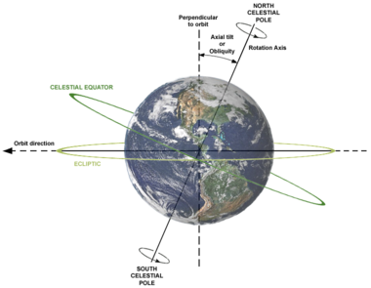
The Earth’s Axial Tilt

Slide 50
ABRAHAM'S.COVENANT.CONFIRMED
38 (Enoch, in the times of the pyramid, down in Egypt.) …How you going to push a boulder up yonder, a half a city block in the air that would weigh a thousand tons. What they had then was the atomic power, just like they got now, and they built it. And that's what they shook the world out of its orbit, 'cause away from the sun throwed it sideways and brought the rains and destroyed the world by water. This time they're going to throw the same thing right straight back into the sun and burn it up again. Just as perfect as it can be. 61-0210

Slide 51
HEB. 11:7
By faith Noah, being warned of God of things not seen as yet, moved with fear, prepared an ark to the saving of his house; by the which he condemned the world, and became heir of the righteousness which is by faith.

Slide 52
CHURCH.AGE.BOOK CPT.9
Oh, little flock, do not fear. This age is fast closing. As it does those tares will be bound together, and as a three-fold cord is not easily broken, they will have a tremendous three-fold strength of political, physical, and spiritual (Satanical) power, and they will seek to destroy the bride of Christ. She will suffer, but she will endure. Fear not those things that are coming upon the earth, for He "Who loved His own, loveth them unto the end." Jn. 13:1.
355-2

