Slide 1
Just Before….
The Final Voice to the Final Age
Part 9
I Corinthians 15:51-53

Slide 2
Birthdays & Anniversaries
June 27th Jessica Coffey
June 28th Ava Jane Brown
June 29th Sherry Frame
July 1st Arne Cross
July 3rd Peter Coffey, Anna Pritchard

Slide 3
Mohammed bin Salman, right, with his father King Salman

Slide 4
IDENTIFICATION
26 Lord, spread forth Your great holy wings tonight. And may Your august Presence be so felt among us, that we'll fear. God, we want to know just our standing place now.
We're checking up, taking inventory of our lives. It might be just before the Rapture, the call away.
63-0123

Slide 5
DANIEL 7:25
And he shall speak great words against the most High, and shall wear out the saints of the most High, and think to change times and laws: and they shall be given into his hand until a time and times and the dividing of time.

Slide 6
QUESTIONS.AND.ANSWERS
242 May we prepare now, Lord. What a wonderful time it will be if we'll just prepare to meet You, Father, and prepare our hearts daily. And if we do make a mistake and fall… let them know that the Blood of Jesus Christ cleanses all sin.
Bring them up, Lord. Rise them up above this cloudy, dismal world: above, where the Sunshine can shine upon their souls again.
62-0527

Slide 7
ELIJAH & THE.MEAL.OFFERING
49 God doesn't require an education and a lot of nonsense; He requires a surrendered heart to His will.
He doesn't ask you to dress in a certain way, or go to certain colleges, or degrees. He asks for a humble, contrite, broken spirit, and a willing heart to receive Him.
60-0310

Slide 8
ISAIAH 57:15
For thus saith the high and lofty One that inhabiteth eternity, whose name is Holy; I dwell in the high and holy place, with him also that is of a contrite and humble spirit, to revive the spirit of the humble, and to revive the heart of the contrite ones.

Slide 9
Fierce: (hard) Gr. skleros
Difficult to pass by without injury. Difficult to pass through without being affected, (eg. Laodicea).
JAMES 3:4
Behold also the ships, which though they be so great, and are driven of fierce winds, yet are they turned about with a very small helm, whithersoever the governor listeth.

Slide 10
THE.SEVEN.CHURCH.AGES
69 You can get forgiveness for crucifying Jesus. You can get forgiveness for taking His Name in vain. "But who speaks against the Holy Ghost will never be forgiven him in this world or the world to come." We're in the last day; so be careful.
Walk humbly. Have a contrite, broken spirit, a humble heart, willing to let the Holy Spirit lead you. Amen.
54-0512

Slide 11
ISAIAH 58:1-2
Cry aloud, spare not, lift up thy voice like a trumpet, and shew my people their transgression, and the house of Jacob their sins. 2 Yet they seek me daily, and delight to know my ways, as a nation that did righteousness, and forsook not the ordinance of their God: they ask of me the ordinances of justice; they take delight in approaching to God.

Slide 12
ISAIAH 54:1
Sing, O barren, thou that didst not bear; break forth into singing, and cry aloud, thou that didst not travail with child: for more are the children of the desolate than the children of the married wife, saith the LORD.
ONCE.MORE
129 Oh, Pentecost, stand at your post this afternoon, your post of the duty of God's Word. Repent, and cry aloud, "Lord God, once more!" Let me tell you something. You had better destroy your enemy before your enemy destroys you.
63-0804

Slide 13
I KINGS 18:27-29
And it came to pass at noon, that Elijah mocked them, and said, Cry aloud: for he is a god; either he is talking, or he is pursuing, or he is in a journey, or peradventure he sleepeth, and must be awaked.
28 And they cried aloud, and cut themselves after their manner with knives and lancets, till the blood gushed out upon them. 29 And it came to pass, when midday was past, and they prophesied until the time of the offering of the evening sacrifice, that there was neither voice, nor any to answer, nor any that regarded.

Slide 14
JUST.ONCE.MORE.LORD
124 Now, just in closing. Pentecost, can we stand at the post of these big organizations, at the post of Hollywood and all other things that separate us from the love of God that's in Christ, and can we stand there and repent, and cry aloud again, "Lord, once more make us pentecost! Once more show Your power into us, Lord! Just once more"?
63-1201

Slide 15
WORKS.IS.FAITH.EXPRESSED
10 I was thinking about, tonight, preaching on a subject of the Rapture, to the church. How the conditions, as I see it in the Scripture, what conditions the Church will have to be in for the Rapture, and what will take place just before the Rapture takes place, and how it will take place. And we all believe in the Rapture, don't we? We believe in It.
65-1126

Slide 16
IS.THIS.THE.SIGN.OF.THE.END.SIR?
245 Number one, the mystery of the Kingdom of Heaven, Matthew 13:3-50.
246 Now, second mystery is the mystery of Israel's blindness during this age. Romans 11:25, with the context.
247 Third mystery is the mystery of the translation of the living saints at the end time of this age. I Cor. 15, and I Thes. 4:14-17.
62-1230

Slide 17
THE.REVELATION.OF.JESUS.CHRIST
349 And he [Joseph] looked at little Benjamin, his throat begin to fill up. Knew them was his. "Let every man leave me." What happened to his wife and children? They went into the palace.
Where will the Gentile Church go at the Rapture? Into the Palace. The Bride, Hallelujah, will be taken off the earth, in the Rapture. Then when He returns, His Bride isn't there when He makes Hisself known to His brethren, the Jews, those who pierced Him, those who rejected Him. 60-1204

Slide 18
THE.FIRST.SEAL
247 And then when he wanted to make himself known, he kept looking at little Benjamin. And he dismissed his wife. She was in the palace when he made hisself known to his brethren. And the Gentile Bride, after Jesus being rejected by His own people, He has taken a Gentile Bride and will take Her from here to the palace to His Father's house in glory for the wedding supper and will slip back down to make Hisself known to His brethren, the 144,000.
63-0318

Slide 19
THE.FEAST.OF.THE.TRUMPETS
257 Remember, the Bride is already in Heaven; Joseph's wife was in the palace. And Joseph dismissed everything from around him, and he made hisself known to his brothers; you see, His Wife and children and them was in the palace when He returns back to make Hisself known to the Jews.
64-0719M

Slide 20
CHURCH.AGE.BOOK
40-2 Where will the Gentile Church go in the rapture? Into the palace. The bride will be taken off the earth. She will be caught up before the great tribulation to meet her Lord in the air. For 3.5 years while the retributive wrath of God is poured out, she will be in the great Marriage Supper of the Lamb. Then will He return, leaving His bride in "His Father's house," while He makes Himself known to His brethren. At this very time, the antichrist covenant that the Jews have made with Rome will be broken. Rome and her allies then send their troops to destroy all the God-fearing, Word-abiding Jews.

Slide 21
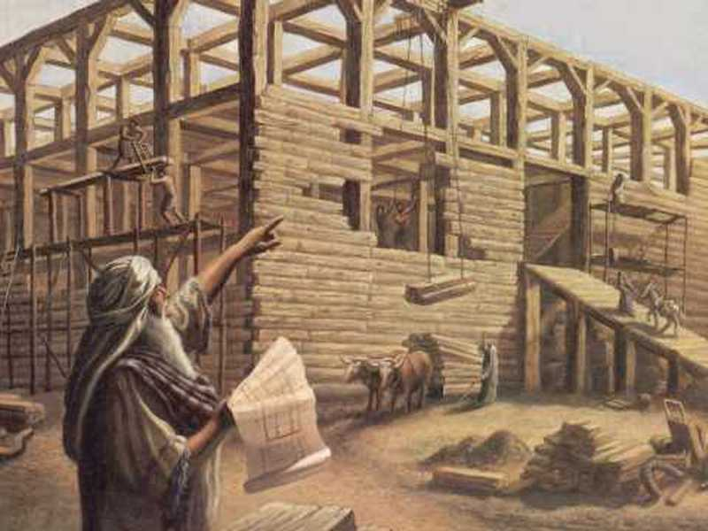
HEB. 11:7
By faith Noah, being warned of God of things not seen as yet, moved with fear, prepared an ark to the saving of his house; by the which he condemned the world, and became heir of the righteousness which is by faith.

Slide 22
JEZEBEL.RELIGION
83 The whole Israelite system went right along with Jezebel. They had a form, yes. And don't the Bible tell us that in this last days they'll have a form of godliness? All the prophecies are fulfilled, brother; we're at the end.
Nationally, we're at the end. Spiritually, we are at the end. Every system is at its end. The next thing is the coming of the Lord and the translation of the Church.
61-0319

Slide 23
QUESTIONS & ANSWERS.3
339. Now, if time ceases when the Seals were opened, then the Millennium is also finished, is it not?
No, no. Time didn't cease when the Seals were opened. Misunderstood it. What happened, the mysteries was revealed, not time ceased. Watch real close now, play your tape if you got it from a tape.

Slide 24
Now, the next thing left is the translation of the church, the return of Moses and Elijah, the Millennium reign upon the earth with the Bride and Groom for a thousand years, and then the judgment bar, and then a total annihilation of sin. Now, the Seals never ended time. Time or seasons until after the Millennium. No. It'll still be time until after the Millennium.
64-0830
CPT.1

Slide 25
CHURCH.AGE.BOOK CPT.9
Oh, little flock, do not fear. This age is fast closing. As it does those tares will be bound together, and as a three-fold cord is not easily broken, they will have a tremendous three-fold strength of political, physical, and spiritual (Satanical) power, and they will seek to destroy the bride of Christ. She will suffer, but she will endure. Fear not those things that are coming upon the earth, for He "Who loved His own, loveth them unto the end." Jn. 13:1.
355-2

Slide 26
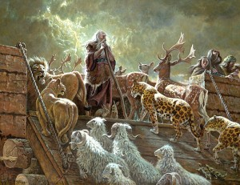
MATTHEW 24:38
38 For as in the days that were before the flood they were eating and drinking, marrying and giving in marriage, until the day that Noe
entered into
the ark…

Slide 27
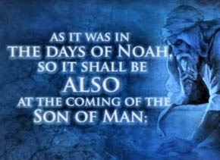
“…before the flood”
Arrogant. Violence Prevailed.
Relied on Science and logic.
Immorality Abounded.
A Time of Mercy Spurned.
The End Came Suddenly.

Slide 28
II PETER 3:10
But the day of the Lord will come as a thief in the night; in the which the heavens shall pass away with a great noise, and the elements shall melt with fervent heat, the earth also and the works that are therein shall be burned up.
I THESSALONIANS 5:1-3
1 But of the times and the seasons, brethren, ye have no need that I write unto you. 2 For yourselves know perfectly that the day of the Lord so cometh as a thief in the night. 3 For when they shall say, Peace and safety; then sudden destruction cometh upon them, as travail upon a woman with child; and they shall not escape.

Slide 29
QUESTIONS.AND.ANSWERS.4
396. Do you believe that sometime the little living Bride will gather somewhere together and have all things in common, as did the first Bride, perhaps just before the coming of the Lord Jesus in the clouds?
Now, they asked me did I believe it. I can't prove it by the Scriptures, but perhaps there will come a time, maybe, I don't know... He said, "But He comes like a thief in the night." Like Romeo and Juliet, He comes and takes away His Bride at night. She's caught away in a moment in a twinkling of an eye.

Slide 30
And it's very doubtful whether it'll be that way, because the Bible said, "There'll be two in a bed; I'll take one and leave one; and two in the field, and I'll take one and leave one." Across the world, they won't be gathered in one place to have things in common. But little groups of them will be scattered all over the earth. Maybe another little group in Asia, one down in Germany, one down somewhere else. When I seen a vision of the Bride the other night, they was made up from the international.
So the Bride won't be gathered from one place; It'll be gathered from all over the world. And that exactly vindicates with the Word, and never has the Word been wrong. And to this time, neither has the vision ever been wrong, because it's been according to the Word. 64-0830

Slide 31
PERSEVERANT
18 And the world was wicked, as it is today, full of science and great man. They had sprung from the sons of Cain. The sons of Seth were humble shepherds, farmers. But the sons of Cain were wise man, builders, inventors, scientists, real smart, real religious. And they had their own form of godliness, but was denying, as it is today, the power of God. And Noah being a just man before God, one day God met him in the fields and talked to him, and told him to build an ark, because He was going to destroy the world with water.
20 Now that was absolutely contrary to all scientific measurements of that day… it had never rained. There was no moisture in the air. 64-0305

Slide 32
PERSEVERANT
18 And the world was wicked, as it is today, full of science and great man. They had sprung from the sons of Cain. The sons of Seth were humble shepherds, farmers. But the sons of Cain were wise man, builders, inventors, scientists, real smart, real religious. And they had their own form of godliness, but was denying, as it is today, the power of God. And Noah being a just man before God, one day God met him in the fields and talked to him, and told him to build an ark, because He was going to destroy the world with water.
20 Now that was absolutely contrary to all scientific measurements of that day… it had never rained. There was no moisture in the air. 64-0305

Slide 33
GENESIS 6:5-7
5 And GOD saw that the wickedness (arrogant, malignant) of man was great in the earth, and that every imagination of the thoughts of his heart was only evil continually. 6 And it repented the LORD that he had made man on the earth, and it grieved him at his heart. 7 And the LORD said, I will destroy (anihilate, eradicate) man whom I have created from the face of the earth; both man, and beast, and the creeping thing, and the fowls of the air; for it repenteth me that I have made them.

Slide 34
CONFLICT.BETWEEN.GOD & SATAN
51 Noah was carried through to preserve seed on the earth… And then just before the flood struck, what happened? Enoch went up; Noah went through. Enoch was translated. Noah's sign was watching Enoch. When Enoch come up missing, then Noah knew the flood was at hand 'cause he was keeping his eye on Enoch.
52 Now, Satan in this time set up the same system that he did in the garden of Eden: reasoning against the Word of these prophets: same thing.

Slide 35
Now, Satan set his system up. He had more than one or two people to deal with now; he had billions to deal with. The antediluvian time, more people probably than there are now. They'd multiplied all over the face of the earth. And Satan, in order not to set up with one, with Eve, he set him up a system. What was it? To combat the Word of the Lord that came to the prophets. He uses that same old tactic every time; and God stays with His thing, the Word.
62-0531

Slide 36
SATAN'S.EDEN
65 Now, he said he would exalt himself above the most High; he would ascend above the clouds and the stars, and he would sit there like God, and be above the most High. And he has succeeded in carrying out his threats. He has certainly had a marvelous success in carrying out his threats, by the people letting him explain away, in every age, the value of God's promised Word to that age. That's exactly how he's done it. In every age, he explained It away.

Slide 37
66 In the days of Noah, he explained that it was impossible for it to rain from heaven, for, "there is no rain up there." His great scientific gospel that he preached in the garden of Eden! He could shoot the instruments to the moon and prove there's no moisture up there. But God said there would come a rain. But Satan succeeded, and poisoned the mind of the people, by scientific research, that, "it could not be done." But it was done. God said it would be done, and it was done. He did.
65-0829

Slide 38
HEB. 11:7
By faith Noah, being warned of God of things not seen as yet, moved with fear, prepared an ark to the saving of his house; by the which he condemned the world, and became heir of the righteousness which is by faith.

Slide 39
LED.BY.THE.SPIRIT.OF.GOD
29 "As it was in the days of Noah, so will it be in the coming of the Son of man." The judgments is bound to strike, for man had continually to get evil. All their thoughts was evil. They had all kinds of devicities like we got today, really a smarter people than we are today. They built the pyramid, and sphinx, and many of those things there that our modern machinery couldn't touch... And how did they ever get them up there? That's the mystery, so perfect mason till a razor blade couldn't go between them: honed down.
30 And they got so smart and so shrewd. And the Bible said they become workers of wood, workers of brass, a great day of science. And they got so smart till they figured they just outsmarted God and didn't need Him any longer. 56-0723

Slide 40
GENESIS 6:13-15
13 And God said unto Noah, The end of all flesh is come before me; for the earth is filled with violence (cruelty and injustice) through them; and, behold, I will destroy them with the earth. 14 Make thee an ark of gopher wood; rooms shalt thou make in the ark, and shalt pitch it within and without with pitch. 15 And this is the fashion which thou shalt make it of: The length of the ark shall be three hundred cubits, the breadth of it fifty cubits, and the height of it thirty cubits.

Slide 41
THE.UNCERTAIN.SOUND
256 But as Noah stood in the door of the ark and warned the people of the oncoming destructions, so is a Gospel preacher that's borned again today standing in the Door, Christ Jesus, enshrouded around by the Holy Ghost, warning the people of a coming destruction. Sure, as it was in the days of Noah, here we are standing in this day.
Now, how could science say, "Rain come from there?" But, you see, God knowed how to bring rain from there.

Slide 42
He either caused an earthquake, or somebody had atomic power that they throwed it and bursted some part of the earth. And it swung the earth backward, throwed it out of its orbit, and now it leans back. And when they did that, the heat of the earth and the cold of the earth, from the sun and away from the sun, caused the cloud to come over. He's Jehovah-Jireh. He can provide Himself anything that His Word said.
60-1218

Slide 43
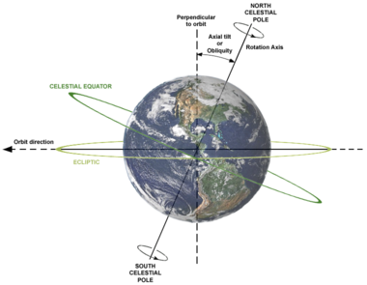
The Earth’s Axial Tilt

Slide 44
ABRAHAM'S.COVENANT.CONFIRMED
38 (Enoch, in the times of the pyramid, down in Egypt.) …How you going to push a--a boulder up yonder, a half a city block in the air that would weigh a thousand tons. What they had then was the atomic power, just like they got now, and they built it. And that's what they shook the world out of its orbit, 'cause away from the sun throwed it sideways and brought the rains and destroyed the world by water. This time they're going to throw the same thing right straight back into the sun and burn it up again. Just as perfect as it can be.
61-0210

Slide 46
QUESTIONS.AND.ANSWERS.3
362. Please explain the mystery of the translation of the Bride.
Just a change (See?), our bodies now... Let's say our…I don't mean to say ours; I don't mean to say this church; I mean to say every believer…
And we cannot receive the promised Son that's promised us today in these bodies that we live in; these bodies are sin… It's not this outside see, taste, feel, smell, and hear. It's subject to death and will die, but the inside part of you, down in here, that is the person that cannot die.

Slide 47
And that's the person that the new life starts from, from this new birth; and it builds another person in the image of this person you are, around that life.
So potentially it's in here, and what is it? The Word promised before the foundation of the world. And around there, this only reflects the negative; that will reflect the positive, the Word. See? And the same thing is--or the translation of the Bride will be the same thing. The Word that's in you, the body will materialize around that Word, and the same thing did by Sarah.
When that old body that she had, that first body, it had to be changed in order to produce a son. That body could not do it. This body cannot do it, so it'll have to be changed the same way to receive the Son.
64-0830

Slide 48
materialize (w)
Become actual fact; happen:
Appear or be present: the train didn't materialize.
Appear in bodily form. Cause to appear in bodily or physical form.

Slide 49
THE.UNVEILING.OF.GOD
82 Who is this great unseen Person? Who is This that Abraham seen in visions? Right at last, though, He was manifested in flesh, before the son came. God Himself came to Abraham in the form of a man, at the end time. Manifested! He saw Him in a little Light one time; he saw Him in visions; he heard His Voice; many revelations. But just before the promised son, he saw Him in the form of a man, and talked to Him, and fed Him meat and drink. Notice, God Himself veiled in human flesh.
83 This is a part of His way. This is the way that He manifests Himself to us, manifests the Eternal Word, God, Jehovah made flesh. Like in John 1:1.

Slide 50
84 Like the attribute, see, it is in God. A attribute is your thought. God in the beginning, the Eternal, He wasn't even a God. He was the Eternal. He wasn't even God; God is an object of worship, or something. So He wasn't even that. He was Elohim, the Eternal. But in Him was thoughts He wanted to become material.
And what did He do? Then He spoke a Word, and the Word was materialized. That's the whole picture, from Genesis to Revelations. It's Elohim materializing so He can be touched, feel. And in the Millennium, there is Elohim sitting on the Throne, with all of His subjects around Him, that He predestinated before the foundation of the world.
64-0614

Slide 51
THE.FOURTH.SEAL
107 Now, we had symbols, and we've probed at it, and done very good sometimes, but we know it's moved right on. But now, in the last days we can look back and see where it has been, and that is supposed to be done that at the end of the church age just before the rapture.
How anyone can get the Church going through the tribulation, I don't know… I'm talking about the Bride.
The Bride won't, no, it hasn't got a sin against it at all. It's done been bleached out, and there's not even smell of it; there's nothing left. They're perfect before God. The church does go through the tribulation, but not the Bride. Noah, the carried over type, went on out into sin. Now, they did go over, but Enoch went first. That was the type of the saints that would go in before the tribulation period.
63-0321

Slide 52
I CORINTHIANS 2:14-16
14 But the natural man receiveth not the things of the Spirit of God: for they are foolishness unto him: neither can he know them, because they are spiritually discerned. 15 But he that is spiritual judgeth all things, yet he himself is judged of no man. 16 For who hath known the mind of the Lord, that he may instruct him? But we have the mind of Christ.

Slide 53
Judgeth: (Gr.) anakrino
To investigate, examine, inquire into, scrutinize, sift, question. In a forensic sense of a judge to hold an investigation; determine excellence or defect of a person or thing.

Slide 54
GETTING.IN.THE.SPIRIT 61-0428
98 If I'd bring this woman up here, say, "The Lord sent me to pray for the sick. Let me lay hands on you, anoint you with oil. Glory to God. You're going to be healed." She's got a right to believe that. That's true. But she could doubt it whether I'm telling her the truth or not… But when the Holy Spirit comes and speaks through my lips and tell her something she has been. That takes the kink out of it right there. 'Cause she knows I don't know her.
If that ain't the Gospel Christ had... Do you say, "Bro. Branham, you say you're the Messiah?" Now, if you think that, it shows you haven't got no spiritual discernment.

Slide 55
How could I be a Messiah? I'm William Branham, a sinner saved by grace. Jesus Christ is the Messiah. His Spirit is alive in us, the Holy Spirit.
99 And some of you people that wouldn't believe it, this thing that makes these people cry, and shout, and speak in tongues, that's the same Spirit. Paul said, "If one comes among you and you all speak with tongues, they'll say you're crazy. But let one be a prophet and reveal the secrets of the heart, and then they will fall down saying, 'God is with you.’

Slide 56
ACTS 17:10-11
10 And the brethren immediately sent away Paul and Silas by night unto Berea: who coming thither went into the synagogue of the Jews. 11 These were more noble than those in Thessalonica, in that they received the word with all readiness of mind, and searched the scriptures daily, whether those things were so.

