Slide 1
The Ministry of Liberty II
GALATIANS 5:1
Stand fast therefore in the liberty wherewith Christ hath made us free, and be not entangled again with the yoke of bondage.

Slide 2
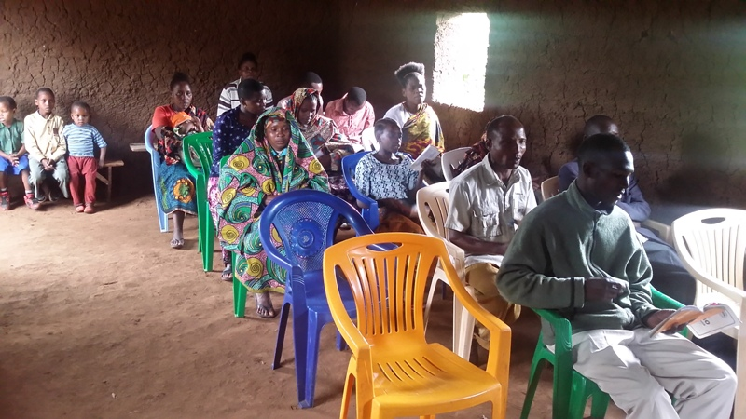
Rumuva Region

Slide 3
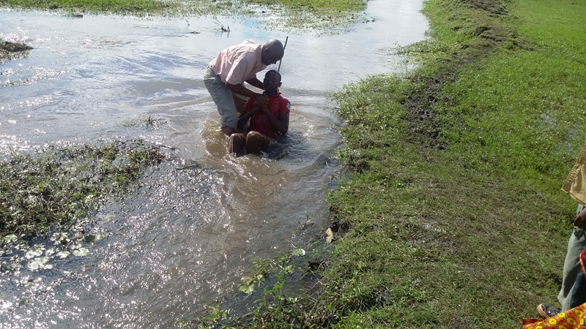

Slide 4
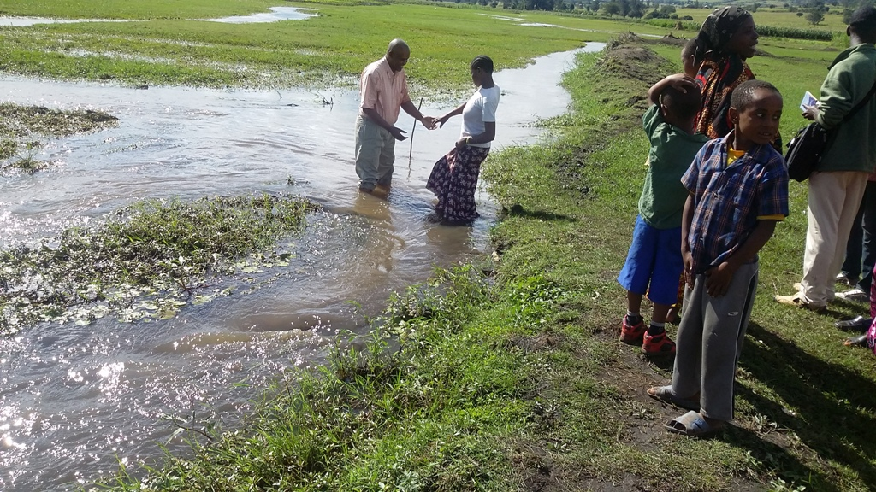

Slide 5
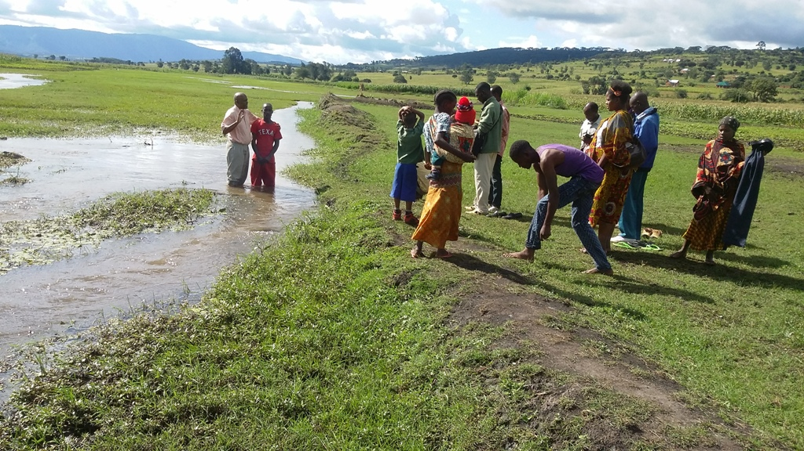

Slide 6
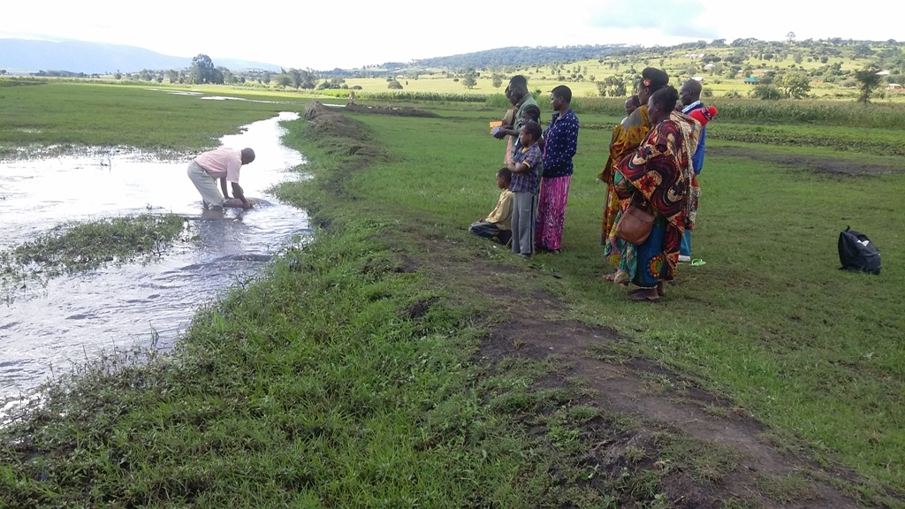

Slide 7
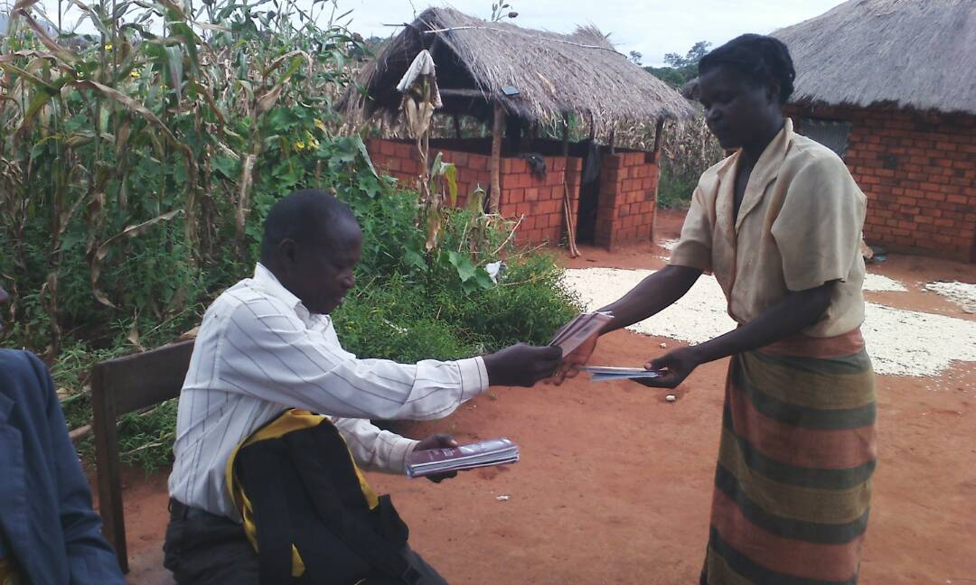
Songea, Tanzania

Slide 8
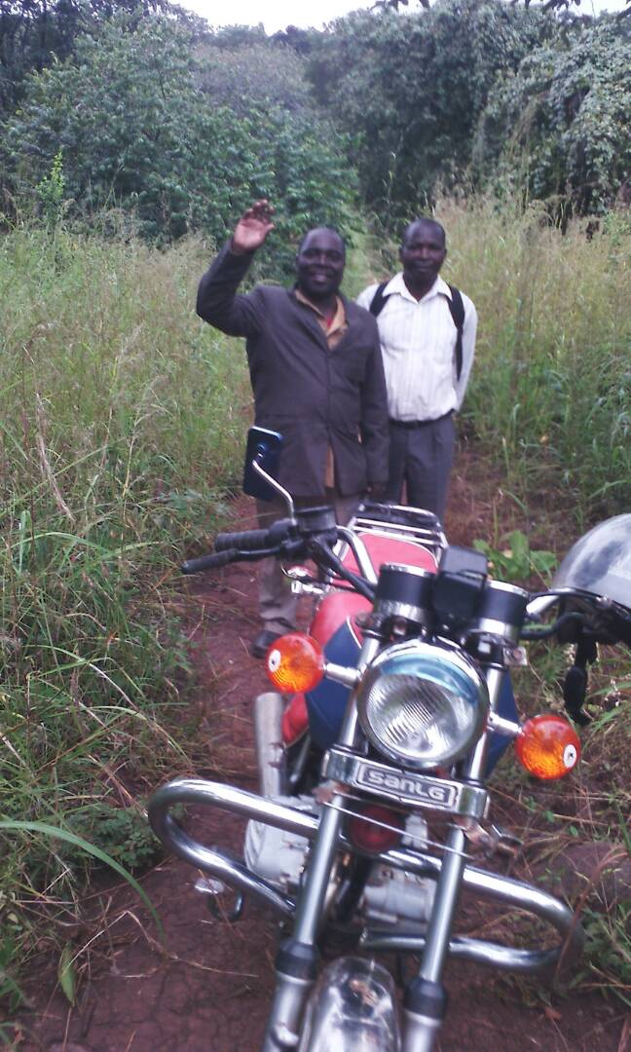

Slide 9
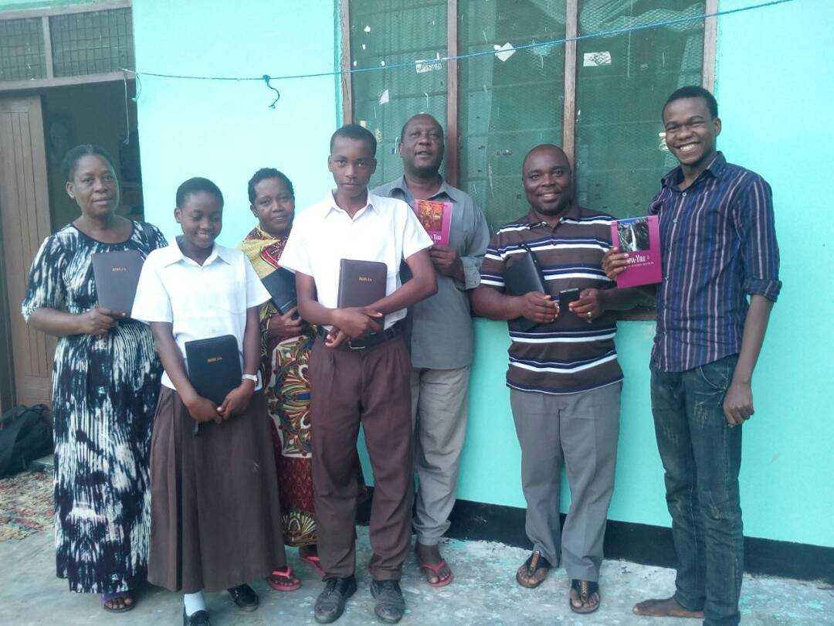

Slide 10
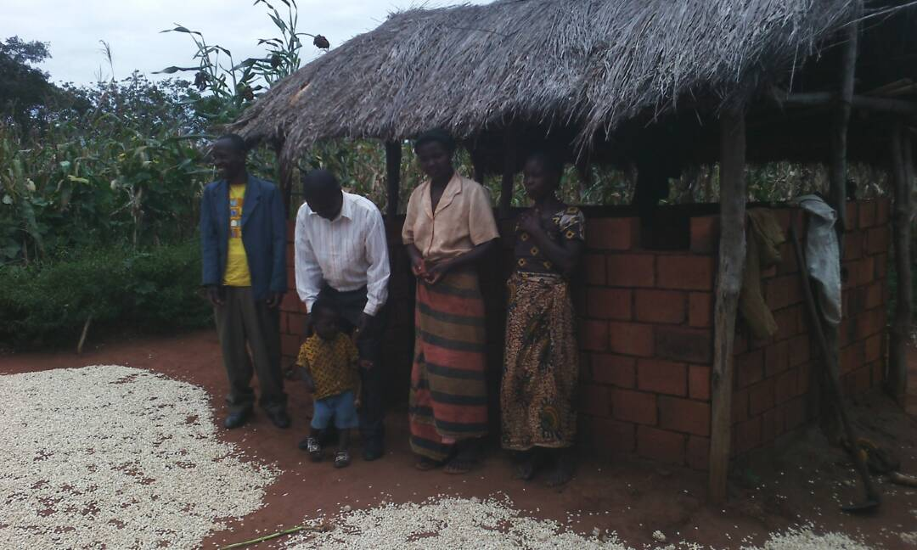
Manyara Region

Slide 11
GALATIANS 5:1,13-26*
1 Stand fast therefore in the liberty wherewith Christ hath made us free, and be not entangled again with the yoke of bondage. 13 For, brethren, ye have been called unto liberty; only use not liberty for an occasion to the flesh, but by love serve one another…
Liberty: (Gr.) eleutheria
The freedom to do or to omit things having no relationship to salvation. (Eg. Home, Car)
A license not to do as one pleases; true liberty is living as we ought to, not as we please.

Slide 12
WHO.IS.GOD
26 Now, many times, people criticizing and poke their finger at me, say, "Well, I brought somebody down there, and they wasn't nothing happened to them." That same old devil that said, "Come down off of the cross, we'll believe You." It still lives in man today...?...
Friend, I couldn't say nothing, to be honest before God, until I knew about it. I listen to one person, and that's God. Managers, I have the best managers in the world.

Slide 13
They can set a meeting anywhere they wish to, but I'm at liberty. Whatever the Spirit of God says do, do it. If He called me from this platform right now to go pray for somebody across the nation, I'd go right now. And no matter what happened here, I'd go right then. It's better to obey than to sacrifice.
50-0815

Slide 14
ROMANS 6:17-20
17 But God be thanked, that ye were the servants of sin, but ye have obeyed from the heart that form of doctrine which was delivered you. 18 Being then made free from sin, ye became the servants of righteousness.
19 I speak after the manner of men because of the infirmity of your flesh: for as ye have yielded your members servants to uncleanness and to iniquity unto iniquity; even so now yield your members servants to righteousness unto holiness.

Slide 15
JAIRUS.A.SECRET.BELIEVER
63 I want to tell everybody just to be real quiet now and keep your children near you, especially epilepsy. Epilepsy is one thing that gets away from me. Do you realize you're dealing with demon spirits? Here not long ago there was a certain minister came to a meeting, had about 28 of his congregation. A little baby was on the platform, and the little baby had epilepsy…
I couldn't get them to stop, and this minister setting out there kinda smiling unto himself, and I looked around. I told them all put their heads down.

Slide 16
They wouldn't do it. This fellow just set there. So an usher went back to him. He said, "Listen, this is a public place, I will do as I please.” I said, "All right. It's up to you. Father, don't let this poor innocent child have to suffer the sins of that man. Now, Satan, you leave him, but you're at liberty to do what you want to."
And thousands of people setting there. There was a whole 28 took epilepsy, fell on the floor frothing, and still got epilepsy too, that's just one of the thousands of cases.
55-0604

Slide 17
1. GALATIANS 2:2-5
And I went up by revelation, and communicated unto them that gospel which I preach among the Gentiles, but privately to them which were of reputation, lest by any means I should run, or had run, in vain. 3 But neither Titus, who was with me, being a Greek, was compelled to be circumcised: 4 And that because of false brethren unawares brought in, who came in privily to spy out our liberty which we have in Christ Jesus, that they might bring us into bondage: 5 To whom we gave place by subjection, no, not for an hour; that the truth of the gospel might continue with you.

Slide 18
2. II THES. 3:1-4
1 Finally, brethren, pray for us, that the word of the Lord may have free course, [spread rapidly] and be glorified, [honored] even as it is with you: 2 And that we may be delivered from unreasonable and wicked men: for all men have not faith. 3 But the Lord is faithful, who shall stablish you, and keep you from evil. 4 And we have confidence in the Lord touching you, that ye both do and will do the things which we command you.

Slide 19
Separation in Goshen:
GENESIS 45:10
10 And thou shalt dwell in the land of Goshen, and thou shalt be near unto me, thou, and thy children, and thy children's children, and thy flocks, and thy herds, and all that thou hast:
11 And there will I nourish thee; for yet there are five years of famine; lest thou, and thy household, and all that thou hast, come to poverty.

Slide 20
DANIEL 7:24
And the ten horns out of this kingdom are ten kings that shall arise: and another shall rise after them; and he shall be diverse from the first, and he shall subdue three kings. 25 And he shall speak great words against the most High, and shall wear out the saints of the most High, and think to change times and laws: and they shall be given into his hand until a time and times and the dividing of time.

Slide 21
JEZEBEL.RELIGION
62 Oh, when Ahab was on the throne... but Jezebel was the head behind that throne. She was the one that done the leading. Look how she took the very laws of the land and twisted them around, and for her own gain and for greed, and made Ahab do it because she was married to him. And that's the way with our leader today. I don't say he isn't a nice man, but look what's behind him: the harlot, the very thing that we run here, to be America for; the very principles that America's built upon... 61-0319

Slide 22
REVELATION 6:7
And when he had opened the fourth seal, I heard the voice of the fourth beast say, Come and see. 8 And I looked, and behold a pale horse: and his name that sat on him was Death, and Hell followed with him. And power was given unto them over the fourth part of the earth, to kill with sword, and with hunger, and with death, and with the beasts of the earth.

Slide 23
REVELATION.CHAP. 5:1
66 We are now approaching, in this age, a cleansing of the sanctuary and the judgments coming upon the earth. As long as Blood is there, God cannot destroy the earth; long as Blood is there, nobody's a sinner before God. Everybody's right, because there's an Atonement for everybody. But if you fail to accept that Atonement and go into His Presence, then you are a sinner, you're beyond that mercy.

Slide 24
Then you've judged yourself. But when the cleansing of the sanctuary comes, the Blood goes off the mercy seat and then the wrath of God falls upon the earth. God be merciful to us, that we be not in that day found without mercies of God. 61-0611

Slide 25
REVELATION 13:4
And they worshipped the dragon which gave power unto the beast: and they worshipped the beast, saying, Who is like unto the beast? who is able to make war with him? 5 And there was given unto him a mouth speaking great things and blasphemies; and power was given unto him to continue forty and two months.
6 And he opened his mouth in blasphemy against God, to blaspheme his name, and his tabernacle, and them that dwell in heaven.

Slide 26
THE.FAITH.OF.ABRAHAM
54 Let the devil say, "Aw, don't you do it; Don't you believe in that." Walk right on in; it's yours. You got an abstract deed on the place. If sickness dwells in there, you got a abstract deed. If you went home tonight, and what if there's an enemy setting in your house. And the enemy said, "Now, wait a minute, this house is built for human being. It's mine just as much as it is your home. I'm just as much human as you are."
You walk right down to the courts, and get your abstract deed, and show him

Slide 27
, "This is my property; it belongs to me."
"Well, Yes, but I'm as much human as you are.” If he won't listen, you can go get the law, and the law will throw him out. When you serve warning on the devil, that he's got his nasty self camped on God's property... Yes.
If he don't want to get out, just call on the authorities of heaven, God's law Agent, the Holy Ghost. He will throw him out. Yes, sir, it's your property. Every Divine promise in the Bible belongs to every Christian.
59-0415

Slide 28
QUESTIONS.AND.ANSWERS.3
358. What does Paul mean by freedom and liberty in Christ? What way is freedom from law?
Well, you're not bound by law. Say, I'll explain in the natural way. For instance, out here it says go down the street, 30 miles an hour is all the faster you can go. Now if I go down the street 40 miles an hour, I'm condemned by the law. But if I go down the street just 30 miles an hour, I'm not under the law. That's freedom in Christ, the same thing. If I don't steal, lie, smoke, commit adultery, any of those things there, I'm not bound by no law. I'm free from the law; I'm in Christ.
64-0830

Slide 29
THE.UNVEILING.OF.GOD
17 Lord Jesus, Thy Word is Truth. And in this troublesome hour that we're living, nation against nation, pestilence, earthquakes in many places, man's hearts failing, fear, we see the handwriting on the wall. Now, that is in the natural realm, that all the world should see this. But now there is a spiritual realm, also, and we see the great happenings, and we want to speak of them today.
64-0614

Slide 30
GOD'S.PROVIDED.WAY
59 (Caged Eagle) And every man that's fell into the snare of the devil is worse off than him. You're supposed to be a son of God. You're free. You got liberty in Christ, believing, God-loving, God-living, free from sin, death.
30 Jesus never set anyone crazy; He set the crazy people at liberty and give them their right mind. That's what the power of God has always did: to liberate the maniacs, put them in their right mind. And no man is perfectly in his right mind until he's found Jesus Christ in his life. 53-061 3

